Slide 1

Settling the Great Australian Rivalry
Is Sydney Better than Melbourne?

Slide 2
We've got Australian booze and the Melbourne Cup each year. Sydney's girls are way out front but we've got stronger beer.
- Idlers Five (Melborn and Sideny)

Slide 3
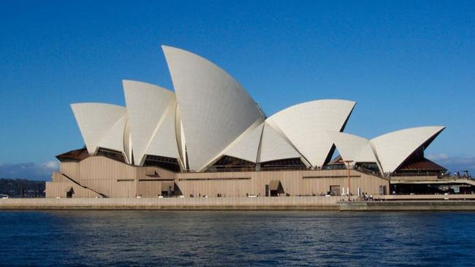

Introduction
Australian’s have always argued over whether Sydney or Melbourne is better
Melbourne claims sport and culture, while Sydney boasts of natural beauty and international appeal
To settle this rivalry, data science and Foursquare data will combine to provide the cold hard facts:
Is Sydney better than Melbourne?
SYDNEY
MELBOURNE

Slide 4


Data
Australian Postcode Data⁽¹⁾
Subset to Sydney and Melbourne
Foursquare Location Data⁽²⁾
Sydney and Melbourne Locations
Locations Grouped by Category
⁽¹⁾ https://www.matthewproctor.com/
⁽²⁾ https://foursquare.com/

Slide 5
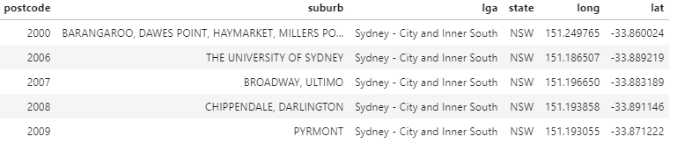
Data: Postcodes
Example
Australian Postcode Data⁽¹⁾
Subset to Sydney and Melbourne
Foursquare Location Data⁽²⁾
Sydney and Melbourne Locations
Locations Grouped by Category
⁽¹⁾ https://www.matthewproctor.com/
⁽²⁾ https://foursquare.com/

Slide 6
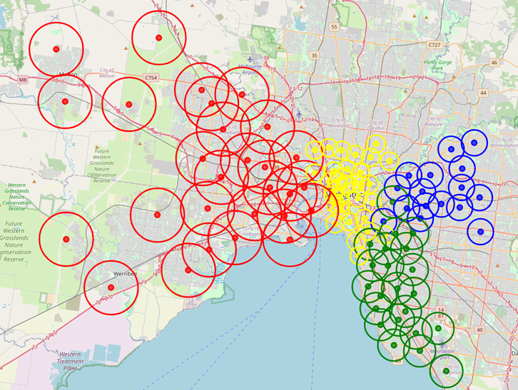
Data: Postcodes – Radius Calculation
Postcode data was used to estimate the size for each of the four local government areas selected for each city
This allowed Foursquare to use an suitable radius in its search for each postcode
Melbourne results are displayed, with inner city postcodes having smaller radii than outer suburbs

Slide 7
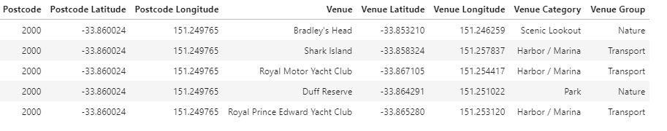
Data: Locations
Example
Australian Postcode Data⁽¹⁾
Subset to Sydney and Melbourne
Foursquare Location Data⁽²⁾
Sydney and Melbourne Locations
Locations Grouped by Category
⁽¹⁾ https://www.matthewproctor.com/
⁽²⁾ https://foursquare.com/

Slide 8
Data: Location Groups
Example
Australian Postcode Data⁽¹⁾
Subset to Sydney and Melbourne
Foursquare Location Data⁽²⁾
Sydney and Melbourne Locations
Locations Grouped by Category
⁽¹⁾ https://www.matthewproctor.com/
⁽²⁾ https://foursquare.com/

Slide 9
Profiling Postcodes
Grouped location data was used to profile postcodes by penetration of each group
The top three location groups are shown for Sydney and Melbourne city centres
Sydney seems more functional with transport its number one feature, while Melbourne appears more consumer-friendly with retail, food and entertainment
Sydney City: 2000
1. Transport 50%
2. Nature 40%
3. Cultural 10%
Melbourne City: 3000
1. Retail 29%
2. International Cuisine 24%
3. Entertainment 16%

Slide 10
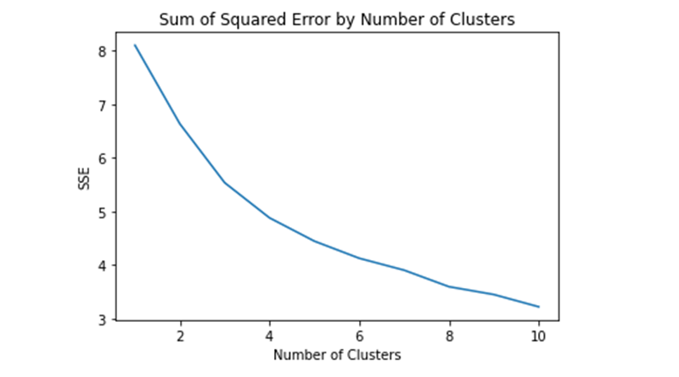
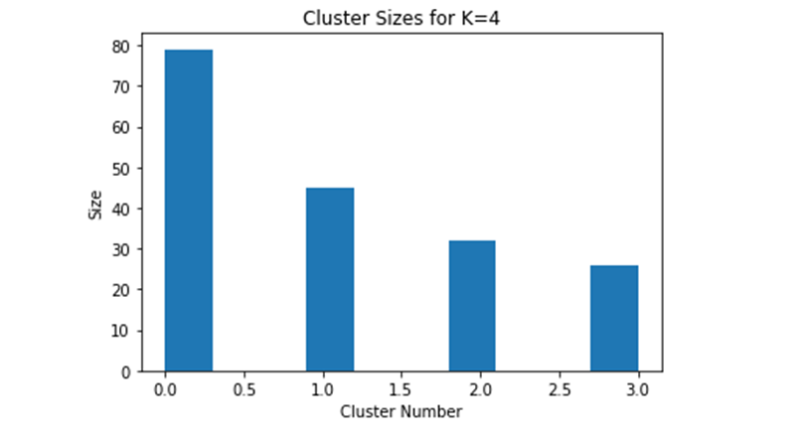
Identifying Types of Postcodes
To compare Sydney and Melbourne, their postcodes needed to be classified using a common framework
The unsupervised technique K-Means clustering divides data into K groups based on their similarity
Four was determined the appropriate number of groups using the “elbow” method, which is shown along with resulting segment sizes

Slide 11

Interpreting the Segments
Using the “average” member for each cluster, the segments were identified and labelled as:
Segment 1: “Retail and Entertainment”
Segment 2: “International Cuisine
Segment 3: “High Volume Retail”
Segment 4: “Nature and Sport”

Slide 12
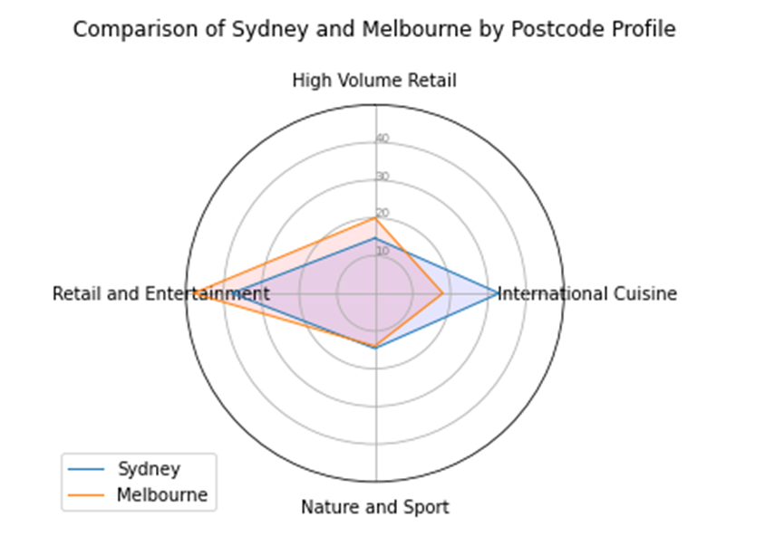
Comparing Sydney & Melbourne
Having identified each postcode as one of four types, results were aggregated to allow comparison of the cities’ features and strengths
The radar plot (right) visualises the results, while the maps on the following slide provide spatial views of the distribution in each city

Slide 13
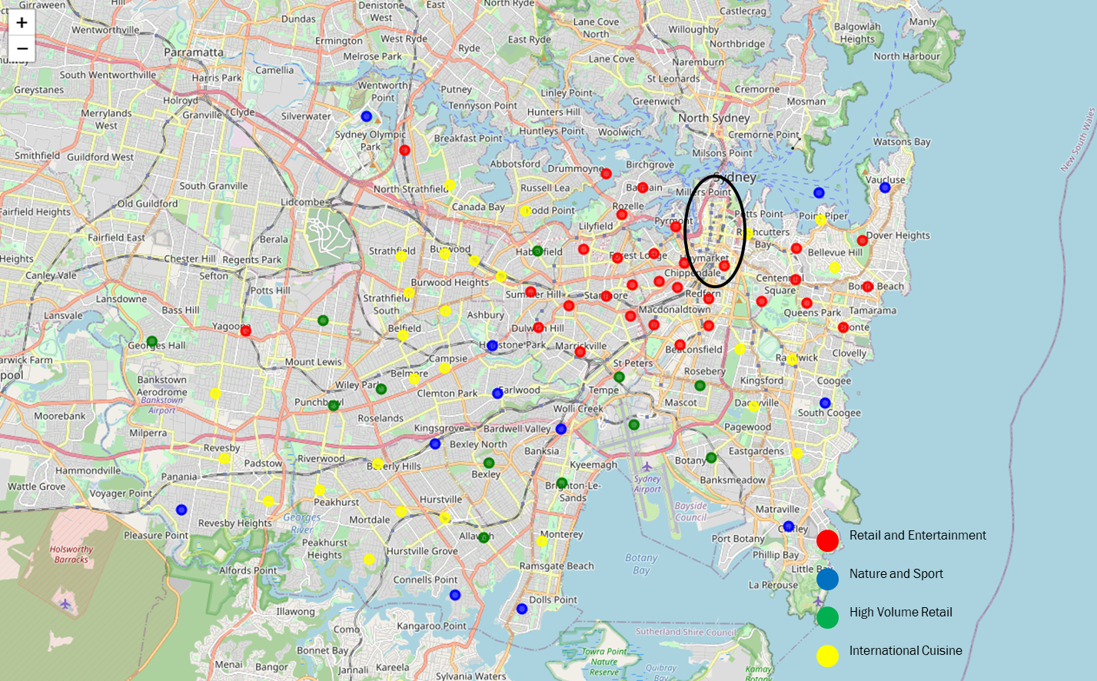
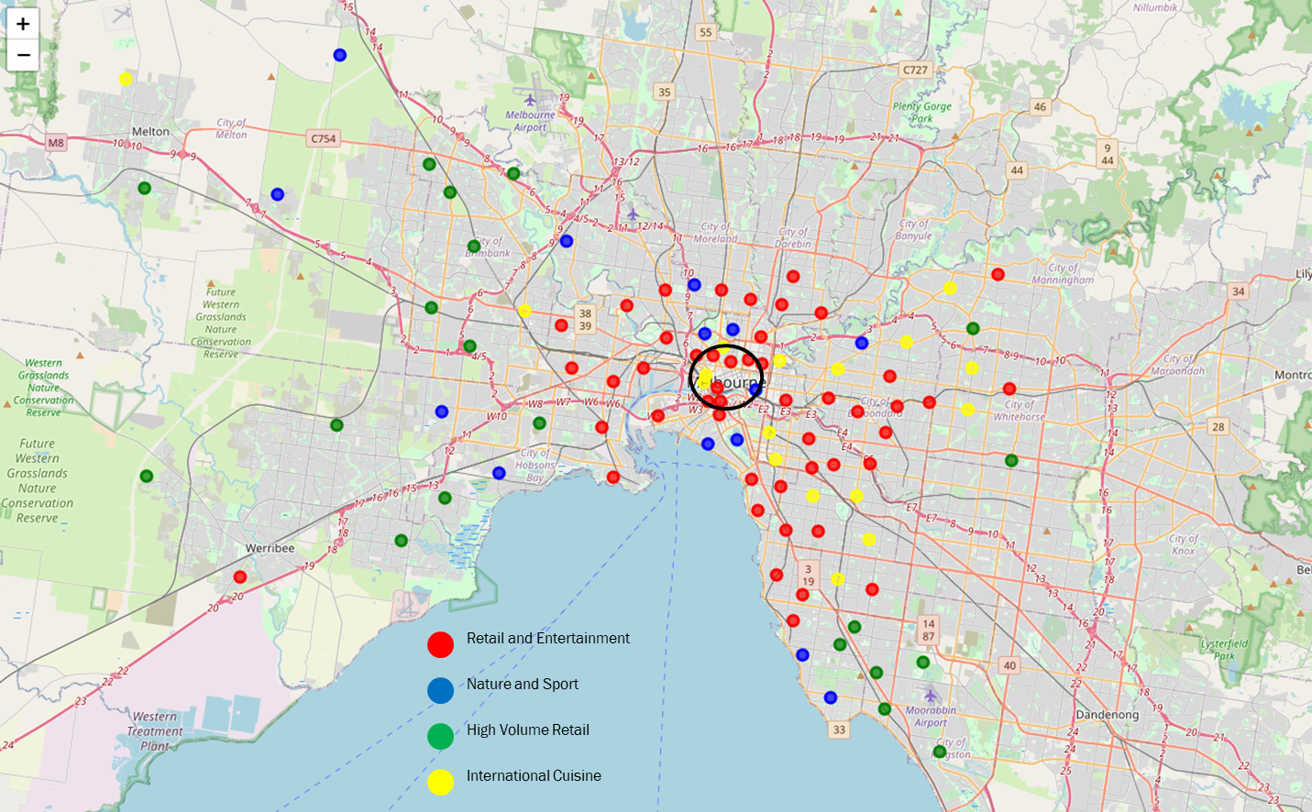
Sydney
Melbourne

Slide 14

Findings
Melbourne is dominated by Retail related postcodes, while Sydney has double the rate of postcodes boasting International Cuisine
While Melbourne and Sydney show similar levels of Nature and Sport, the individual contribution of nature and sport in each city is not known
Both cities show a tendency of Retail and Entertainment postcodes around the CBD, with High Volume Retail further out
Sydney’s Nature and Sport is centred around water, while Melbourne’s is more diverse, incorporating parks and mountains
In line with Sydney’s prevalence of International Cuisine, its geographic distribution is more dispersed than Melbourne

Slide 15
Conclusion
With Sydney matching Melbourne in sports and nature and demonstrably proving its international status, it is clearly living up to its claims as natural beauty and international city
Melbourne on the other hand failed to demonstrate one of its key claims: that of cultural superiority
The analysis does, however, have the potential for human bias, through the crowd sourced Forsquare data and the objective categorisation and cluster analysis
Potential weaknesses aside, the analysis provides a clear answer to the question:
Which is better? Sydney or Melbourne…

Slide 16

And the winner is… Sydney

